Slide 1
Mergers and acquisition of Telecom industry
MOUNIKA(121823901001)
SAMSON(121823901004)

Slide 2
TELECOM INDUSTRY
The one of the most profitable industry in the World is “Telecom” and it is rapidly growing day-by-day and observed as an indispensable section of the worldwide utility and services sector. This industry not only generates annual revenue of approx. $950 billion but also contribute to World GDP which is around 1.5%.
At present around 5.8 billion mobile users which are equal to nearby 81% of the World population and out of it around 75% customers are in the worlds highly populated Countries India and China. As a result companies in the sector find it strategically desired to enter new markets by merger & acquisitions and or forming an alliance with existing strong players in the market.

Slide 3
CLIENT- AIRTEL
TARGET COMPANIES
GTL Infrastructure- telecom tower company
TEJAS NETWORK- communications equipment and solutions
STERLITE TECHNOLOGIES-designing, building and managing smarter digital networks.
HFCL LTD-designer, manufacturer, assembler and seller of telecommunication equipment.

Slide 4
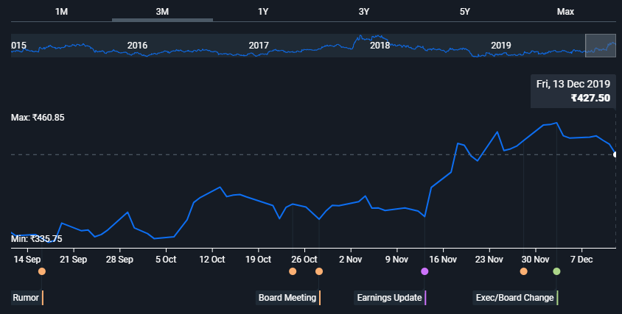
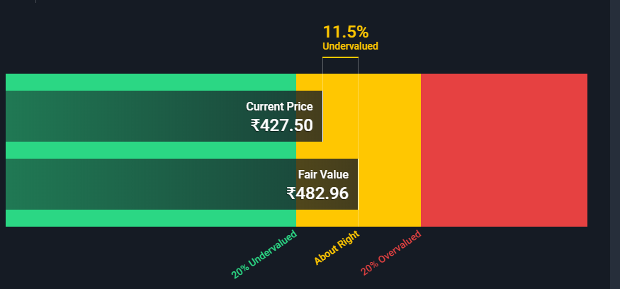

Slide 5
AIRTEL- SWOT
STRENGHTS
Biggest mobile service provider in world’s second largest telecom market
Well-established nationwide infrastructure
High brand equity
Superior overall network quality and reliability
WEAKNESSES
High competition in the telecom market
Debt and finances
Late adoption of 3G and advanced wireless technologies

Slide 6
Opportunities
Untapped voice market
3G and data revenue
LTE
Mergers and Acquisitions
Threats
Unfriendly regulatory environment
Spectrum Auctions and Reframing
Mobile Number Portability

Slide 7
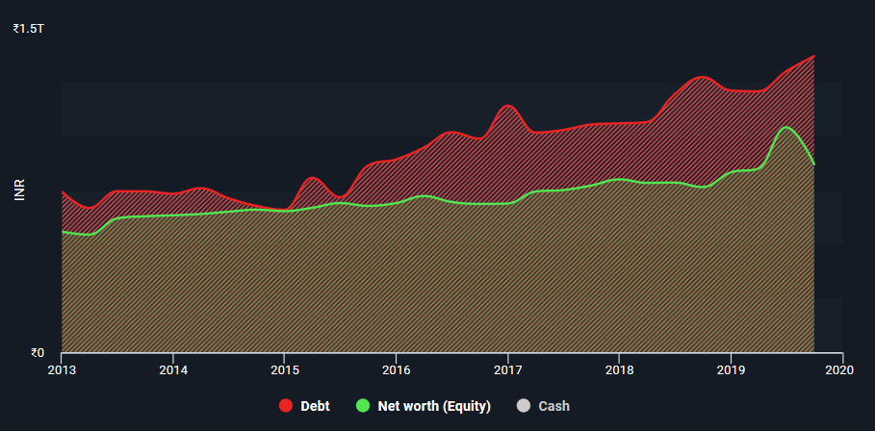
AIRTEL DEBTS- Very High
DEBT 1.32 T
Equity 870.15

Slide 8
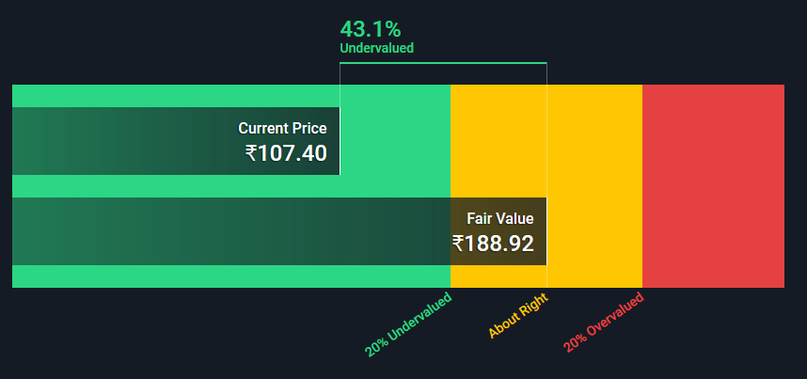
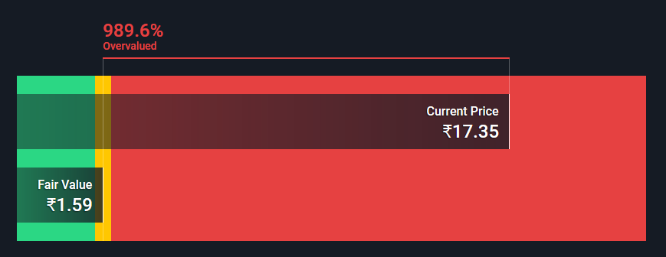
Sterlite
HFCL

Slide 9
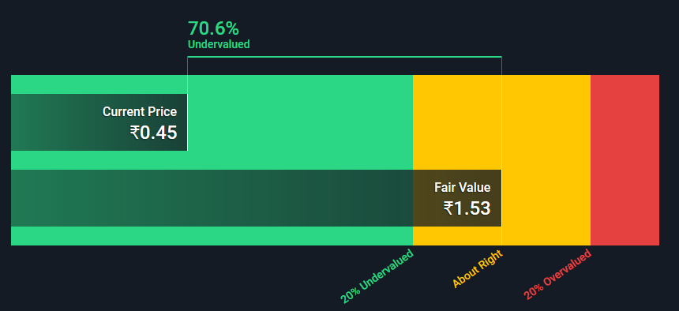
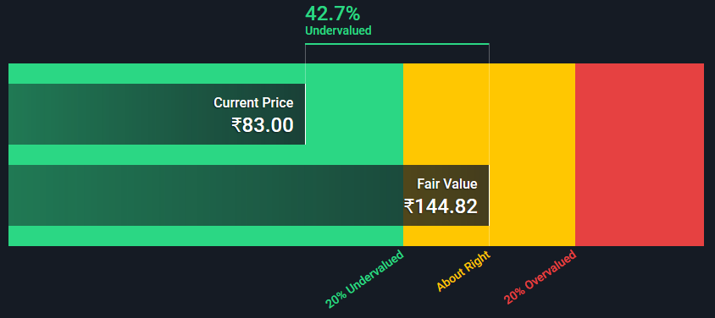
GTL Infrastructure
Tejas Network

Slide 10
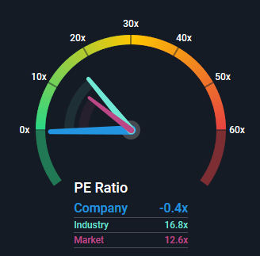
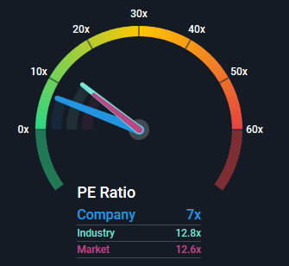
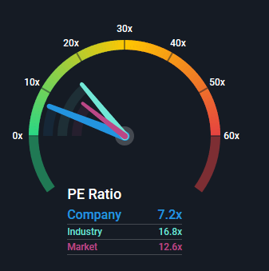
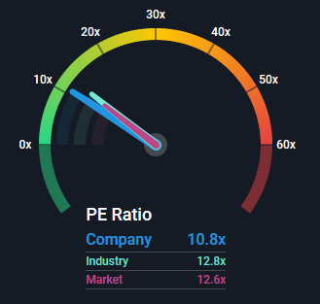
Sterlite
GTL
P/E Ratio
Tejas Network
HFCL

Slide 11
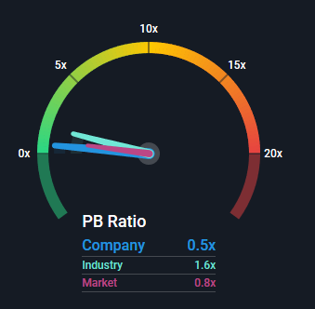
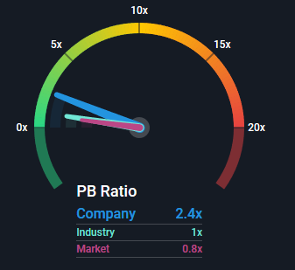
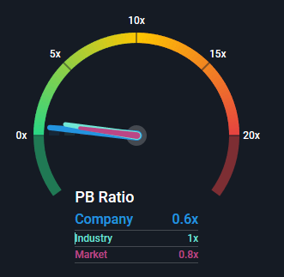
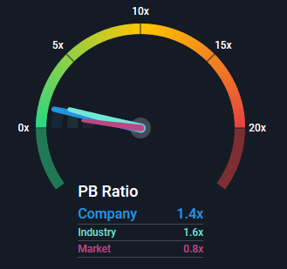
GTL
Sterlite
P/B ratio
Tejas Network
HFCL

Slide 12
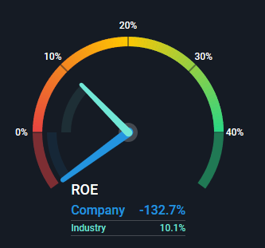
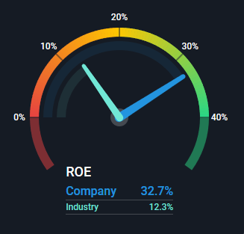
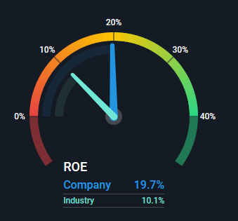
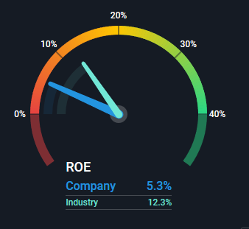
GTL
11.66B
Sterlite
18.19B
HFCL
16.17B
Tejas Network
13.16B

Slide 13
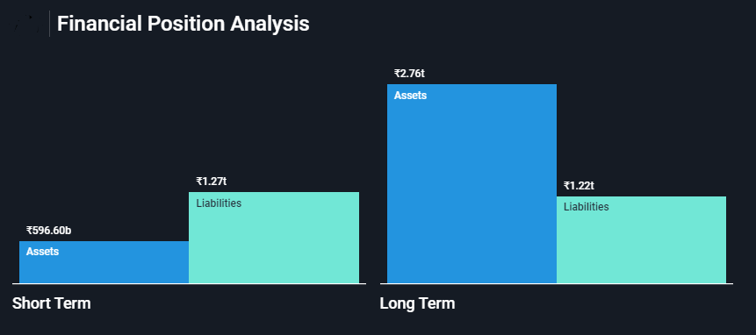
Airtel

Slide 14
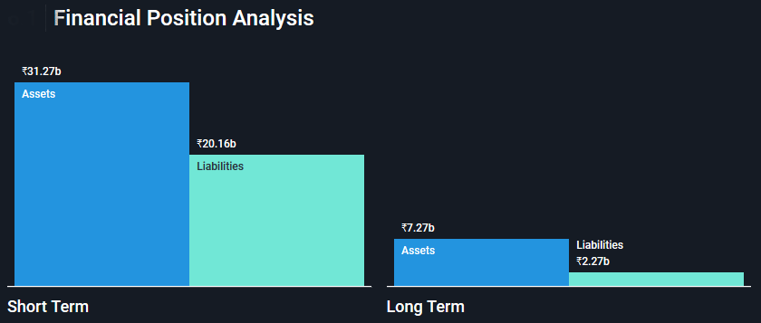
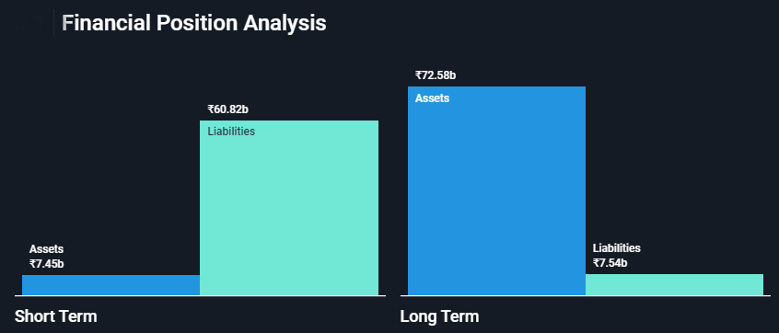
HFCL
GTL

Slide 15
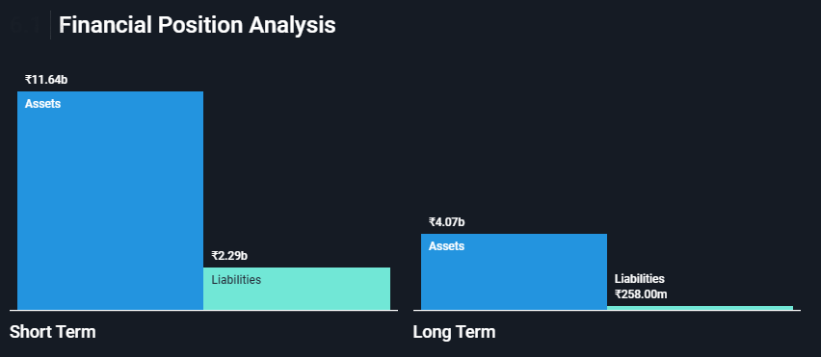
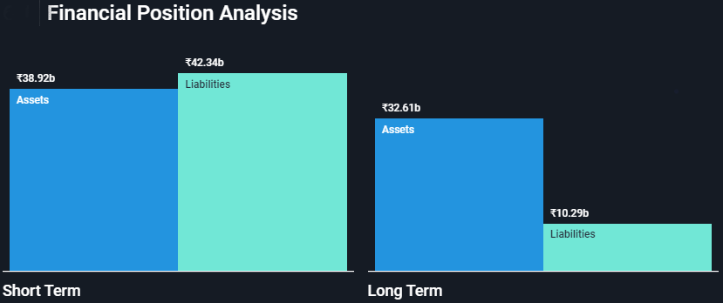
TEJAS NETWORK
STERLITE

Slide 16
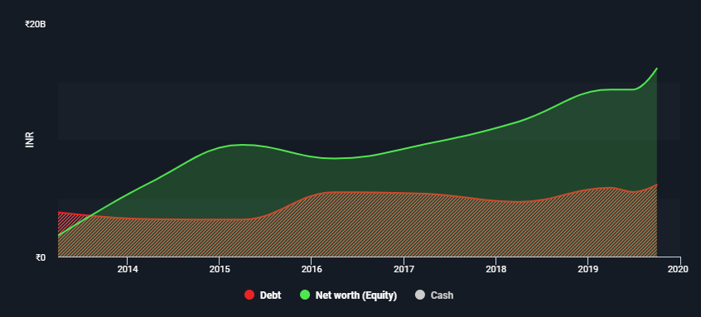
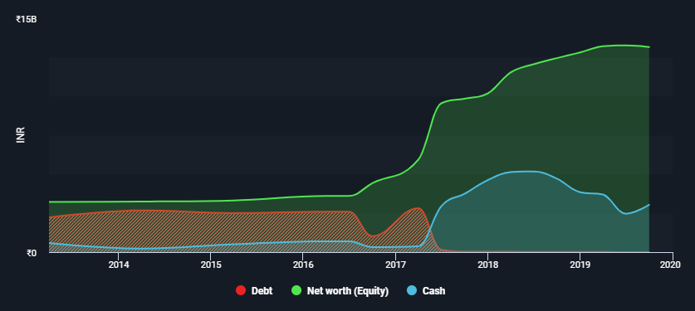
Debt to Equity Analysis
TEJAS NETWORK
HFCL

Slide 17
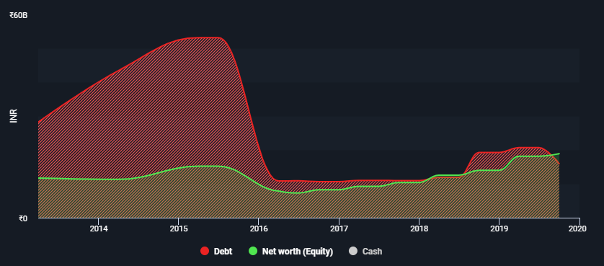
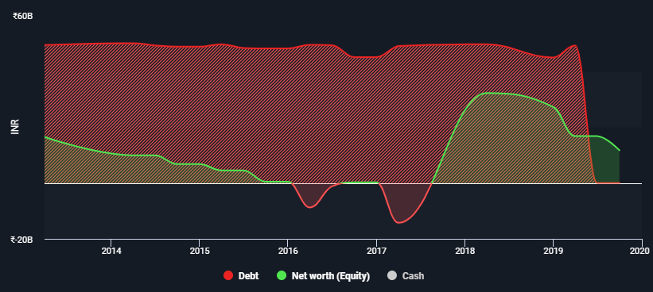
STERLITE
GTL

Slide 18
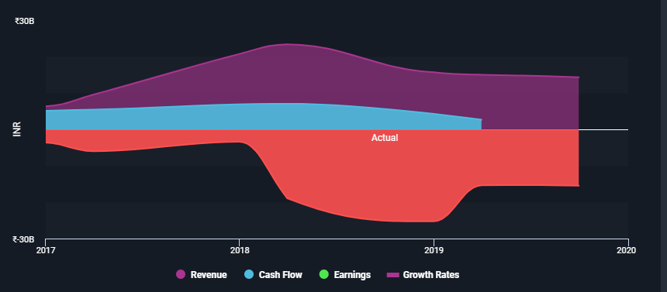
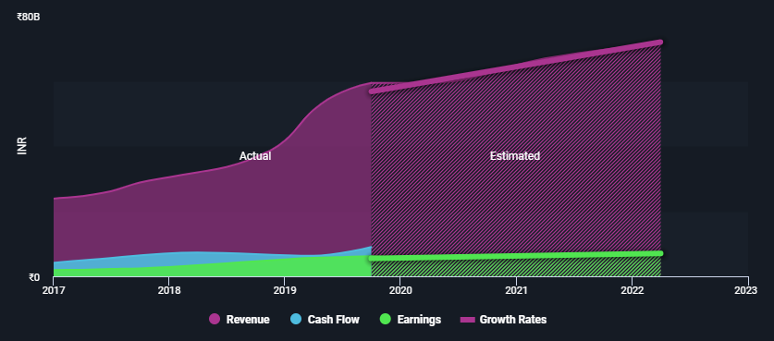
REVENUE AND EARNINGS
GTL
STERLITE

Slide 19
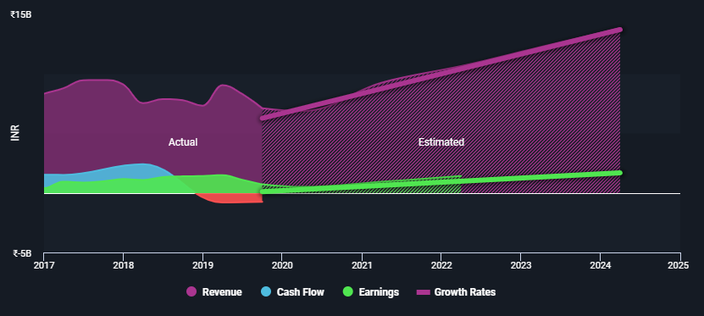
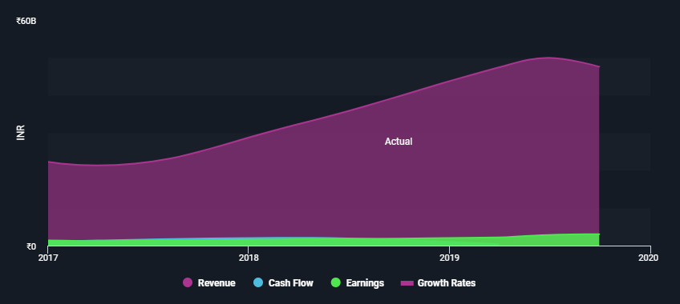
TEJAS
HFCL

Slide 20
Conclusion
Taking each company individually and assessing the synergies we understood that GTL provides negative incomes with its existing debts and Airtel already having huge debts would not have much benefit out of GTL.
On the other hand,Tejas Network, could be a potential acquisition target with its future growth, it is undervalued right now and has less working capital involved and has good earnings in the future.
So,Airtel can target TEJAS NETWORK to get benefit in operational segments adding profitability and growth.

Slide 21
Valuation of Target company-Purchase
Shares of Tejas Network- 92.12M
Tejas-Market : Airtel-Market Vale 83:422
Ratio 1:0.342311578
Tejas Fair :Airtel- Market Ratio 144: 422
Ratio 1:0.19
Price Range ₹ 7,64,61,90,300.00-₹ 13,30,85,76,400.00
The Company can be purchased through stock by issuing the stocks share of range 17502800-31533742
The final Price range would be ₹ 10,47,73,83,350.00 - 24518271 stocks

